Slide 1
Strengthening R2O2R for the Nation
Brent Gordon
NOAA/SWPC
03 June 2024

Slide 2
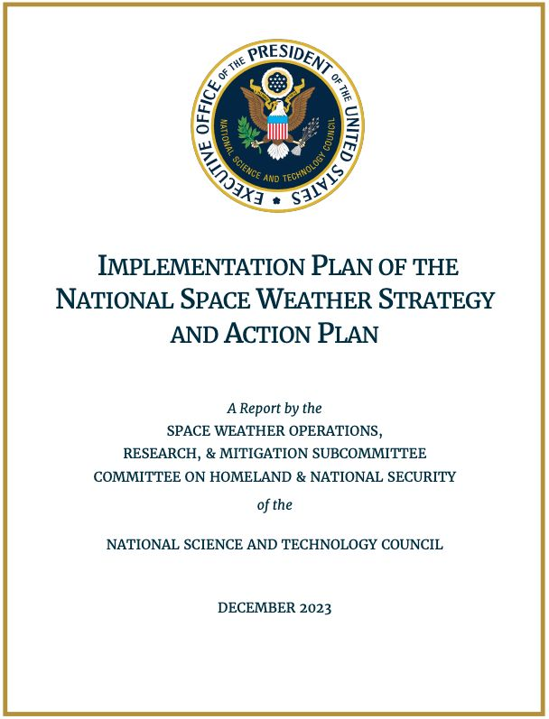
One Govt Response to Space Weather
Similar Charge from 3 different Administrations
Provide right info, right time, right people to protect our infrastructure and our way of life
Congressional Authorization
PROSWIFT
Most Recently - NSW-SAP Objective 2:
Develop and disseminate accurate and timely information of space weather characterization and forecasts

Slide 3
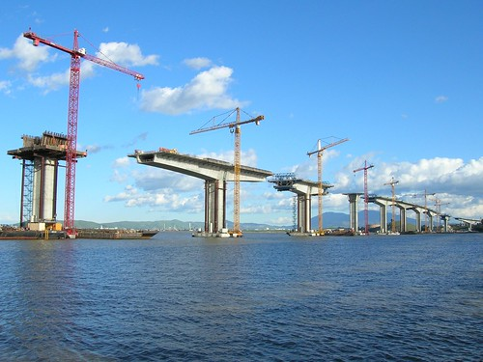
Building the Bridge from R-2-O
CCMC helps SWPC with GEM Challenge 2011
NASA and NSF begin O2R Grants in 2018
Annual calls for all but one year
NASA CCMC Architecture for Collaborative Evaluation 2021
First Proving Ground activity
NASA Space Weather Centers of Excellence 2023
NOAA Space Weather Prediction Testbed Exercises 2022 & 2023

Slide 4
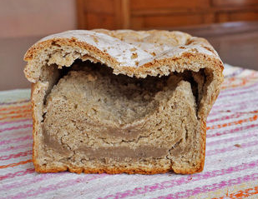
So where are all the new capabilities?
R2O of the O2R Grants has been slow
Not quite what we need (basic vs applied)
Not quite there (not quite baked?)
No one there to receive it (open the door!)
SWPC’s bandwidth too limited for too long!
Means we have been unable to help mature capabilities from the proving grounds to operations
We require “plug-n-play”
Does not exist!
SWPC (and NOAA) are working on that!

Slide 5
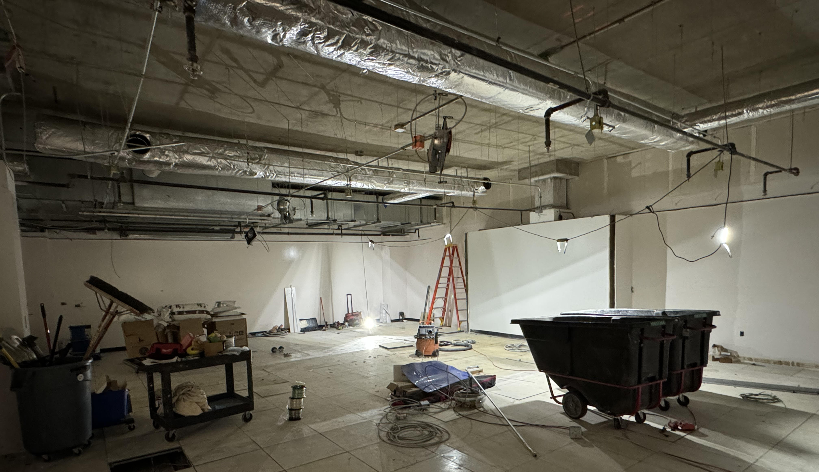
NOAA’s Efforts to Accelerate R2O2R
2023 - Funded the construction of a collaborative Workspace
GSA Contractor still working on it
2024 - Hiring staff dedicated to transition efforts (5-6 new)
Software Developers, Scientific Programmers, Cloud Experts
Chris Siewert & Steve Hill
2024-2025 - Buildout of cloud environment
Allow external collaborators access to operational-like environment

Slide 6
One NOAA Strategy
Goals
Close the gaps along the SWx value chain.
Establish an applied research and development (R&D) capability within NOAA to assimilate data more effectively into its models and accelerate the research-to-operations- to-research (R2O2R) cycle.
Build and develop SWx Workforce.
Eliminate skill gaps and keep pace with the maturing SWx Value Chain.
Connect NOAA’s SWx groups into a holistic and effective “One-NOAA” SWx cross line office team.
Establish processes and practices to ensure One-NOAA SWx entity operates as a seamless, single enterprise, working towards a shared vision of SWx priorities.
Outcomes
NOAA Space Weather Research Capability
NOAA Office of Oceanic and Atmospheric Research (OAR)
Invigorated NOAA Space Weather Modeling Program
Observation R2O & Data Assimilation
Ground Based Space Weather Observations Program
Enhanced capacity for R2O within NOAA
Timeframe
FY2026 Funding Request
Barriers
Workforce (not enough!)
Budget cycles (not quick enough)

Slide 7
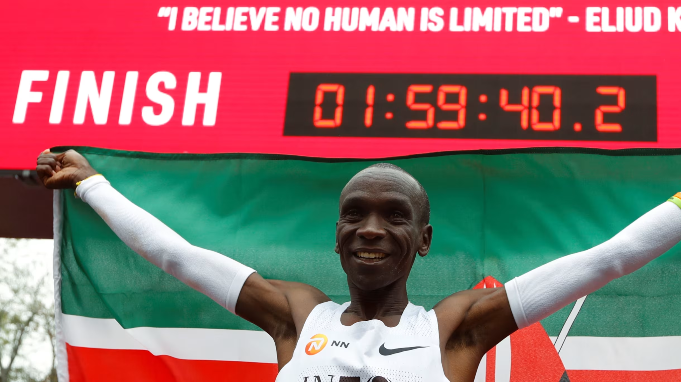
So where are we anyway?
Is R2O2R where we want it to be (or expect to be) today?
Should we be surprised that we are not deftly moving new capabilities into operations?
Have we built the starting blocks for a better R2O2R capability?
Will this get easier?

